Slide 1
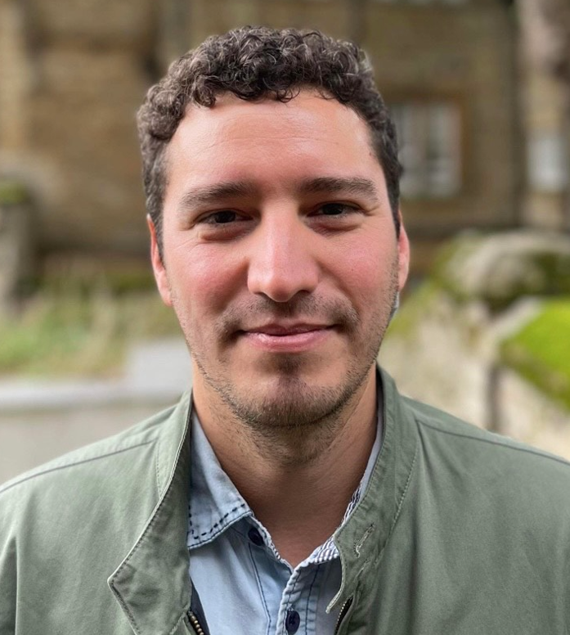
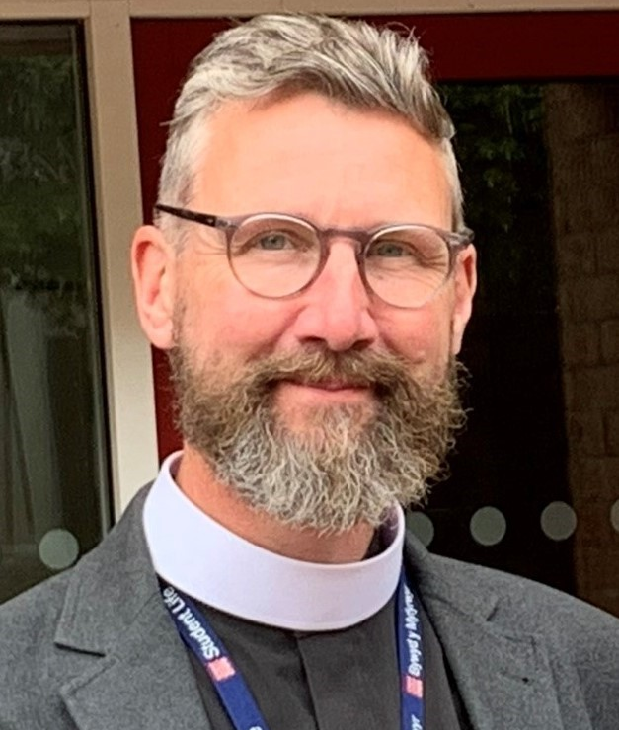
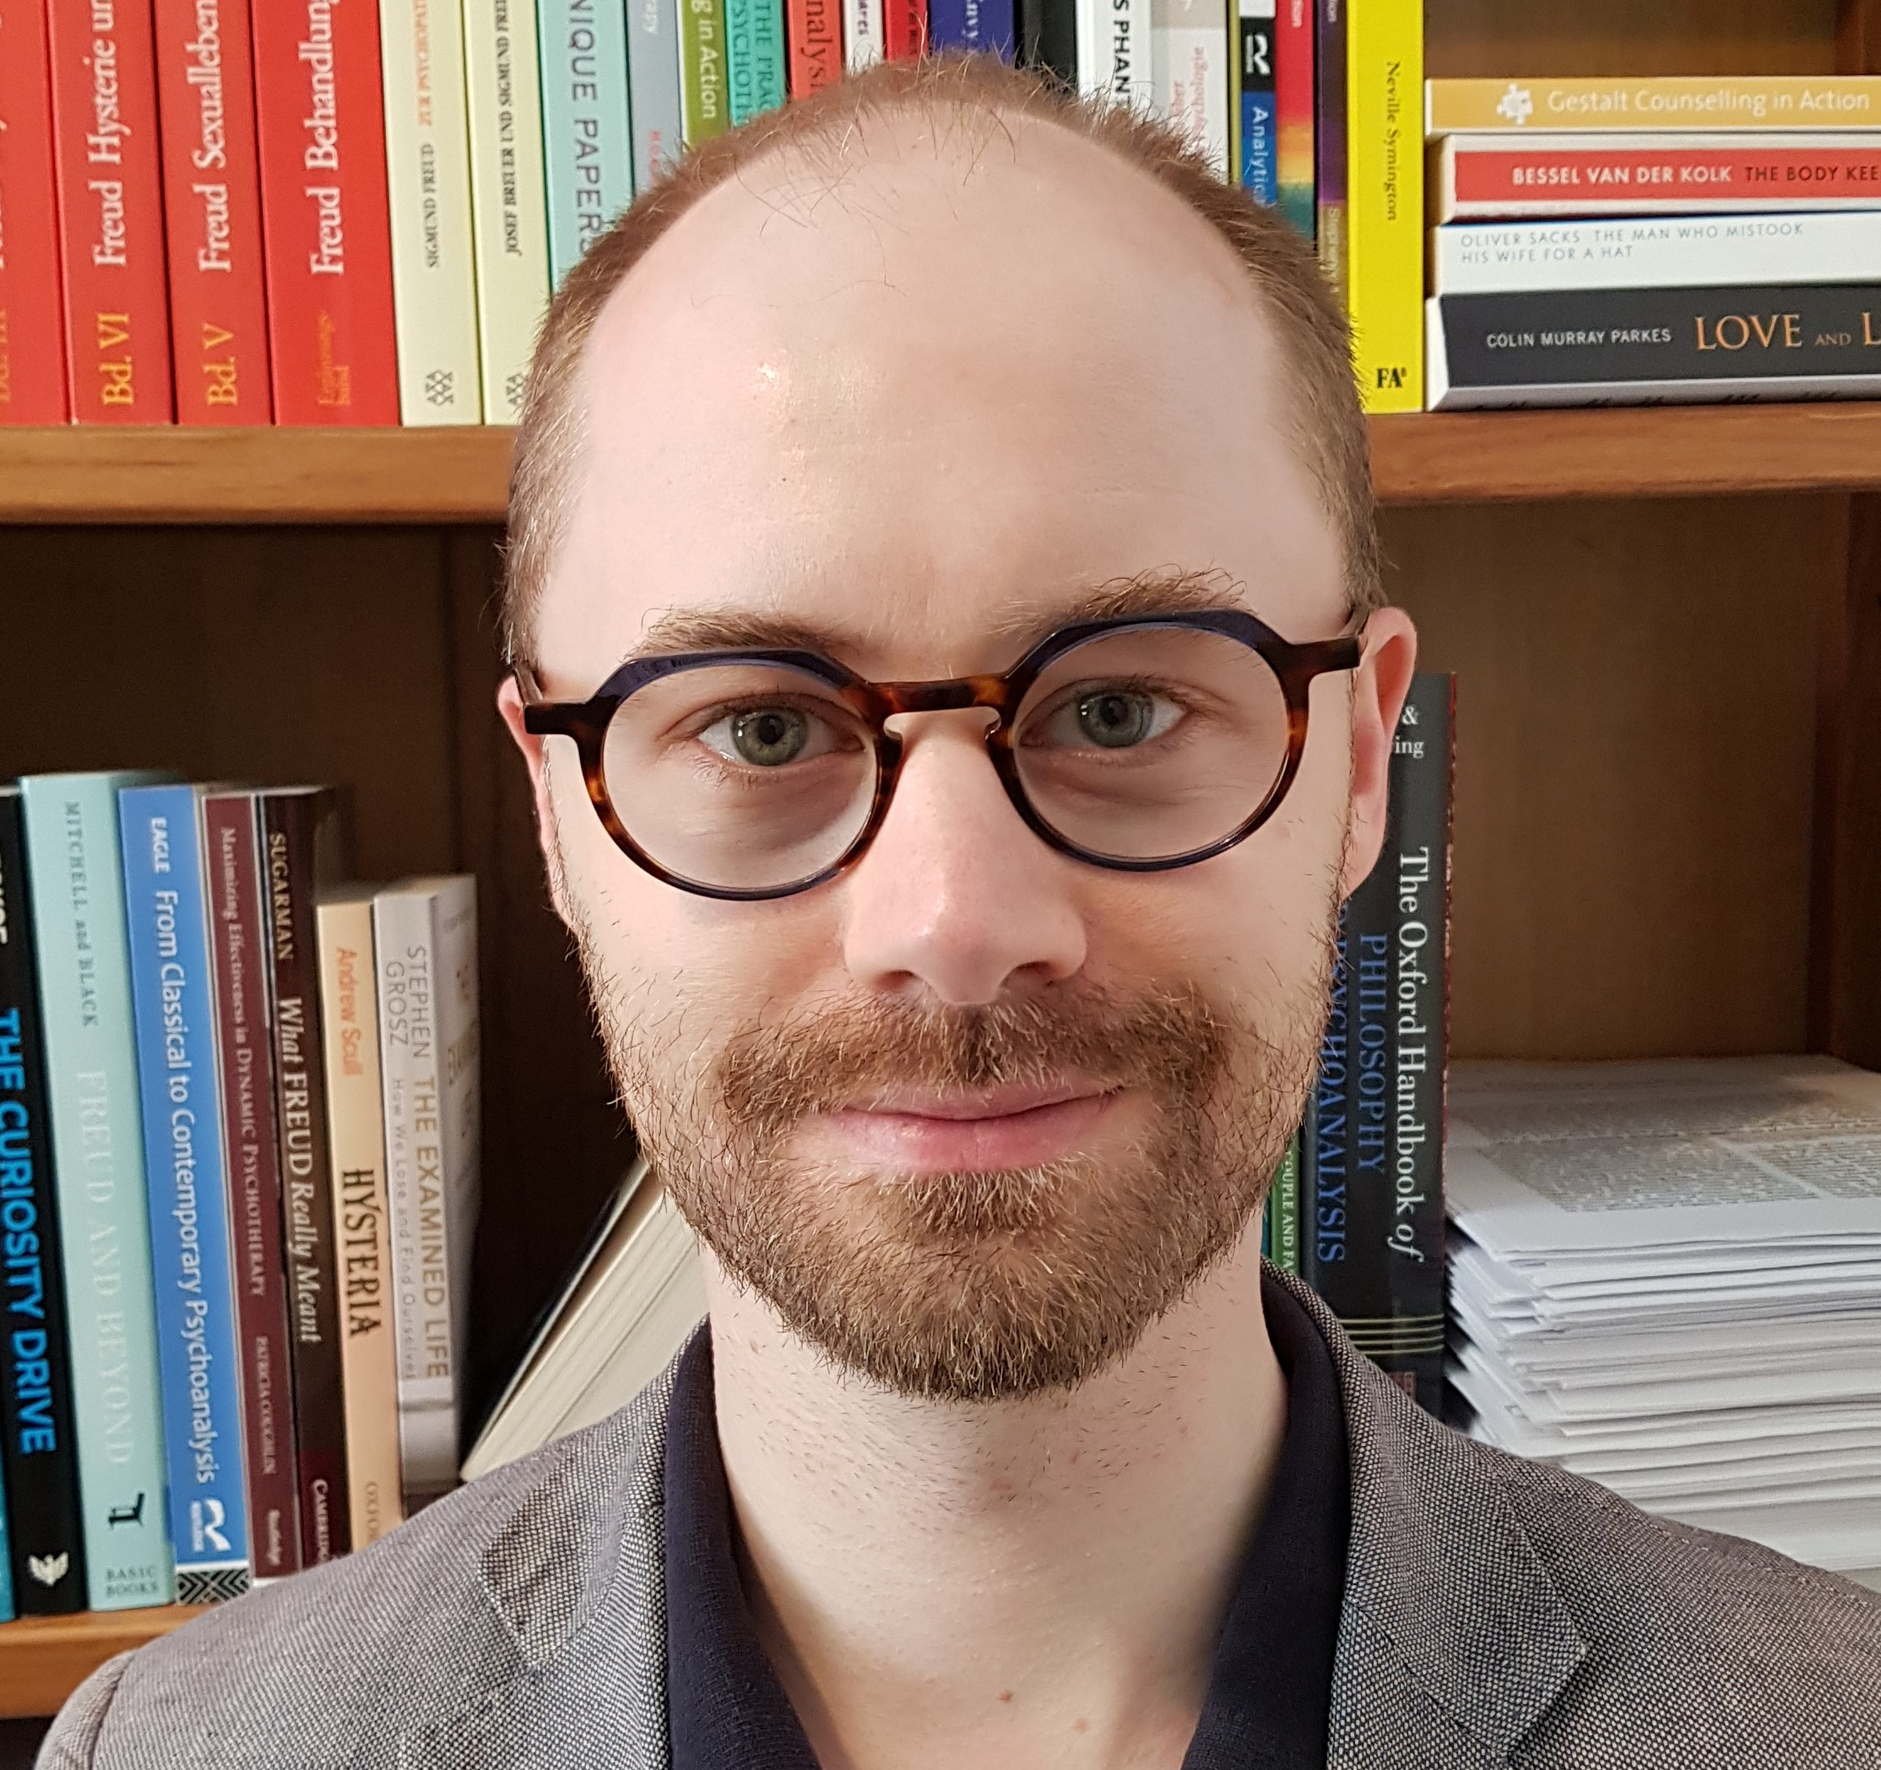
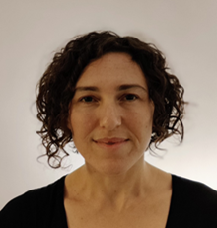
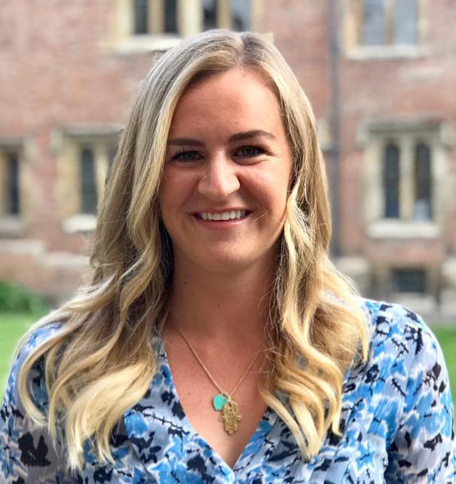
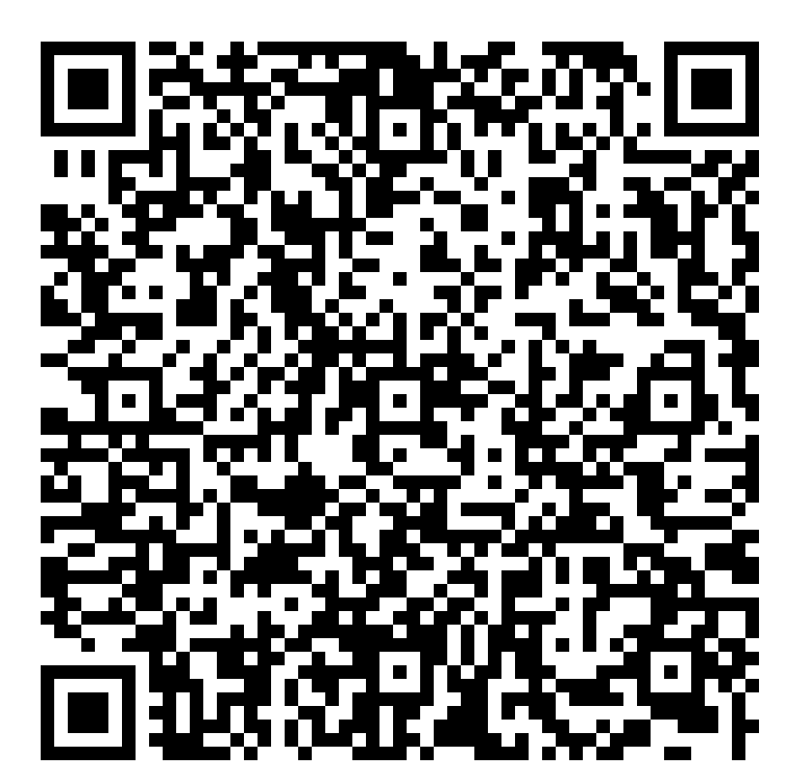
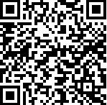
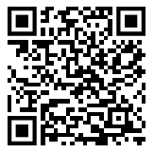
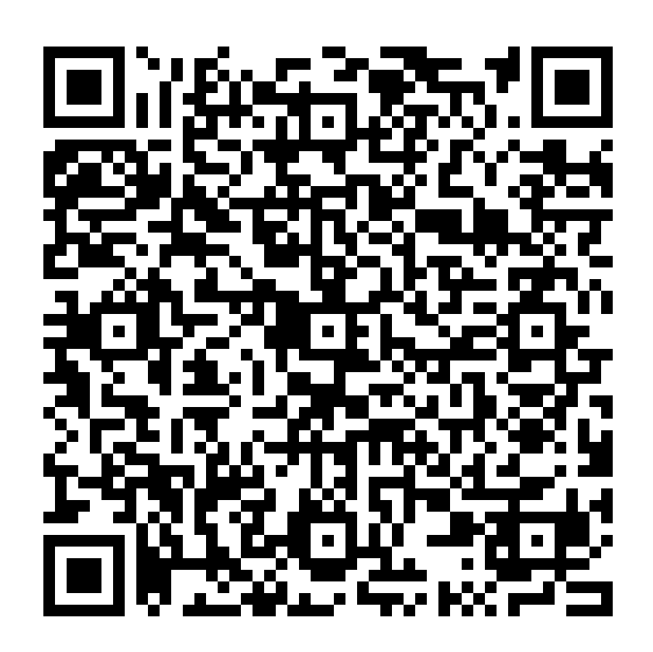
BRASENOSE COLLEGE STUDENT WELFARE
For All Emergencies Contact The Porters’ Lodge: 01865 277830 (or after hours 9pm-7am 07710 916095)
Emergency Services call 999 / NHS service call 111 / Samaritans 116123
Dean
Prof Simon Shogry
dean@bnc.ox.ac.uk
Phone via Porters’ Lodge
Sub Dean
Dr Arnaud Petit
subdean@bnc.ox.ac.uk
Phone via Porters’ Lodge
Chaplain
Revd David Sheen
chaplain@bnc.ox.ac.uk
Phone 01865 77833
Diversity & Equality Harassment Officer
Dr Anne Edwards
anne.edwards@bnc.ox.ac.uk
Phone via Porters’ Lodge
Safety and Security Manager
Andy Talbot
andrew.talbot@bnc.ox.ac.uk
Phone via Porters’ Lodge
College Counsellor
Dr Sebastian Petzolt
studentsupport@bnc.ox.ac.uk
Contact Hours in weeks 0-10
Monday: 11:30-12:00 and 13:00-16:30 / Thursday: 13:00-15:00 /
Friday: 12:00-14:00 Students can book via: https://www.bnc.ox.ac.uk/collegecounsellor or QR Code
College Nurse
Kinneret Milgrom
surgeries are: Mon 9:00am-12noon / Tues 9:00am-12noon / Weds 3:00pm-6:00pm / Thurs 3:00pm-5.00pm / Fri 8:00am-12noon or book an appointment in surgery hours here:https://www.bnc.ox.ac.uk/collegenurseOr QR Code
College Doctor: Jericho Health Centre
01865 311234
Arthur Disegna
Junior Dean
junior.dean@bnc.ox.ac.uk
Bessie O’Dell
Junior Dean
junior.dean@bnc.ox.ac.uk
Faojia Sultana
Junior Dean
junior.dean@bnc.ox.ac.uk
Junior Deans are available 6pm-8am Monday – Sunday in Term
Night Line (8pm-8am) in term-time, call 01865 270270, run by students for students
JCR Welfare Officers &
JCR Peer Supporters:
QR Code:
HCR Welfare Officers &
HCR Peer Supporters:
QR Code:
Night Line (8pm-8am) in term-time, call 01865 270270, run by students for students

